Slide 1
Reinforcement Learning

Slide 2
Reinforcement learning
Reinforcement Learning is the agent must sense the environment, learns to behave (act) in a environment by performing actions (reinforcement) and seeing the results.
Task
- Learn how to behave successfully to achieve a goal while interacting with an external environment.
- The goal of the agent is to learn an action policy that maximizes the total reward it will receive from any starting state.
Examples
– Game playing: player knows whether it win or lose, but not know how to move at each step

Slide 3
Applications
A robot cleaning the room and recharging its battery
Robot-soccer
invest in shares
Modeling the economy through rational agents
Learning how to fly a helicopter
Scheduling planes to their destinations

Slide 4
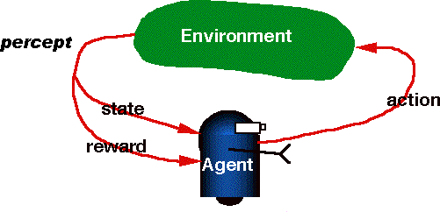
Reinforcement Learning Process
RL contains two primary components:
Agent (A) – RL algorithm that learns from trial and error
Environment – World Space in which the agent moves (interact and take action)
State (S) – Current situation returned by the environment
Reward (R) – An immediate return from the environment to appraise the last action
Policy (π) –Agent uses this approach to decide the next action based on the current state
Value (V) – Expected long-term return with discount. Oppose to the short-term reward (R)
Action-Value (Q) – Similar to value except it contains an additional parameter, the current action (A)
Figure shows RL is learning from interaction

Slide 5
RL Approaches
Two approaches
Model based approach RL:
learn the model, and use it to derive the optimal policy.
e.g Adaptive dynamic learning(ADP) approach
Model free approach RL:
derive the optimal policy without learning the model.
e.g LMS and Temporal difference approach
Passive learning
The agent imply watches the world during transition and tries to learn the utilities in various states
Active learning
The agent not simply watches, but also acts on the environment

Slide 6
Reinforcement learning model
Each percept(e) is enough to determine the State(the state is accessible)
Agent’s task: Find a optimal policy by mapping states of environment to actions of the agent, that maximize long-run measure of the reward (reinforcement)
It can be modeled as Markov Decision Process (MDP) model.
Markov decision process (MDP) is a a mathematical framework for modeling decision making i.e mapping a solution in reinforcement learning.

Slide 7
MDP model
MDP model <S,T,A,R>
S– set of states
A– set of actions
Agent
Transition Function: T(s,a,s’) = P(s’|s,a) – the probability of transition from s to s’ given action a
T(s,a) → s’
State Action
Reward
Environment
Reward Function: r(s,a) → r the expected reward for taking action a in state s
a₀ a1
_{s2} a2
s
s
s3
0
r
1
r1
r2
0
R(s, a) = ∑ P(s'| s, a)r(s, a, s')
s'
R(s, a) = ∑T (s, a, s')r(s, a, s')
s'

Slide 8
Q - Learning
Q-Learning is a value-based reinforcement learning algorithm uses Q- values (action values) to iteratively improve the behavior of the learning agent.
Goal is to maximize the Q value to find the optimal action-selection policy.
The Q table helps to find the best action for each state and maximize the expected reward.
Q-Values / Action-Values: Q-values are defined for states and actions.
Q(s, a) denotes an estimation of the action a at the state s.
This estimation of Q(s, a) will be iteratively computed using the TD- Update rule.
Reward: At every transition, the agent observes a reward for every action
from the environment, and then transits to another state.
Episode: If at any point of time the agent ends up in one of the terminating states i.e. there are no further transition possible is called completion of an episode.

Slide 9
Q-Learning
Initially agent explore the environment and update the Q-Table. When the Q-Table is ready, the agent will start to exploit the environment and taking better actions.
It is an off-policy control algorithm i.e. the updated policy is different
from the behavior policy. It estimates the reward for future actions and appends a value to the new state without any greedy policy. Temporal difference(TD) learning is one of the model-free reinforcement learning techniques
Temporal Difference or TD-Update:
Estimate the value of Q is applied at every time step of the agents
interaction with the environment.
Advantage:
Converges to an optimal policy in both deterministic and nondeterministic
MDPs.
Disadvantage:
Suitable for small problems.

Slide 10
Bellman Equation
In the context of Q-learning, Bellman's equation is utilized to determine the value of a specific state and evaluate its relative placement.
The optimal state is determined by the state with the highest value.
The Bellman's equation can be represented as
Q(state, action) = R(state, action) + Gamma * max[Q(next state, all actions)]
Where,
Q(s,a) represents the expected reward for an action 'a' in state 's'.
R (s,a) represents the reward earned when action a is carried out in state 's'.
ɑ is the discount factor, which denotes the significance of future rewards.
maxaQ(s',a) represents the maximum Q-value for the next state s' and every possible action.

Slide 11
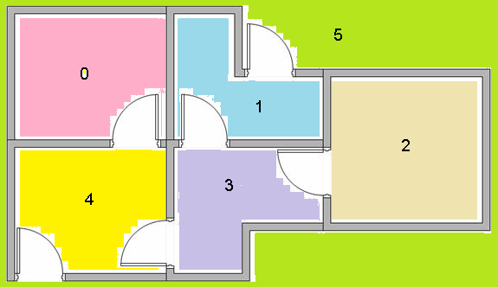
Understanding the Q – Learning
Building Environment contains 5 rooms that are connected with doors.
Each room is numbered from 0 to 4. The building outside is numbered as 5.
Doors from room 1 and 4 leads to the building outside 5.
Problem: Agent can place at any one of the rooms (0, 1, 2, 3, 4). Agent’s goal is to reach the building outside (room 5).

Slide 12
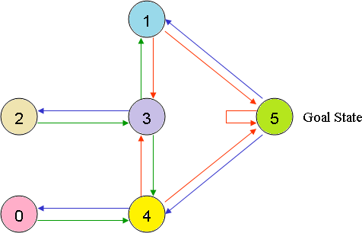
Understanding the Q – Learning
Represent the room in the graph.
Room number is the state and door is the edge.

Slide 13
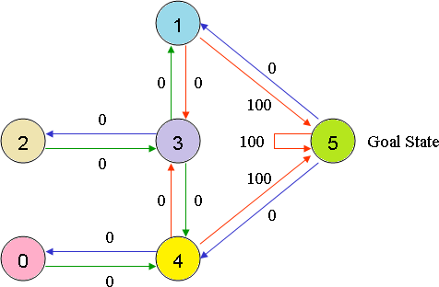
Understanding the Q – Learning
Assign the Reward value to each
door.
The doors lead immediately to target is assigned an instant reward of 100.
Other doors not directly connected
to the target room have zero
reward.
For example, doors are two-way ( 0 leads to 4, and 4 leads back to 0 ), two edges are assigned to each
room.
Each edge reward value
contains an instant

Slide 14
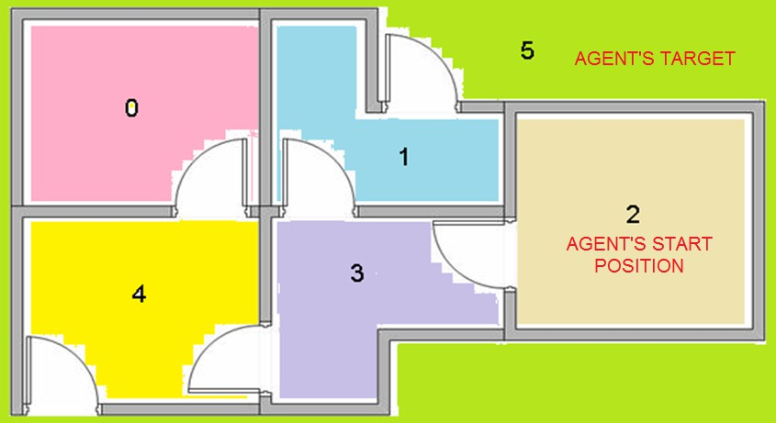
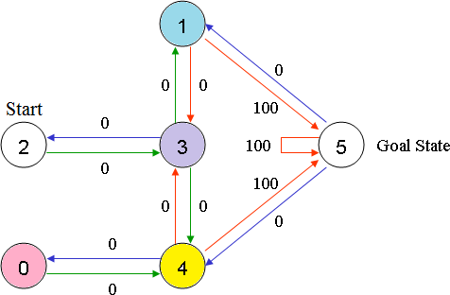
Understanding the Q – Learning
Let consider agent starts from state s (Room) 2.
Agent’s movement from one state to another state is action a.
Agent is traversing from state 2 to state 5 (Target).
Initial state = current state i.e. state 2
Transition State 2 → State 3
Transition State 3 → State (2, 1, 4)
Transition State 4 → State 5

Slide 15
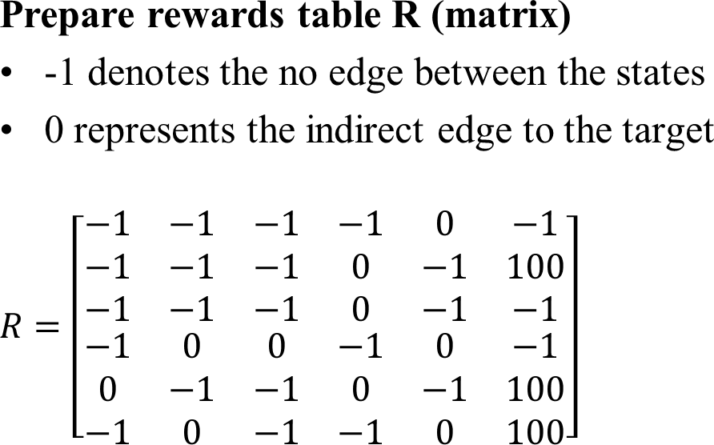
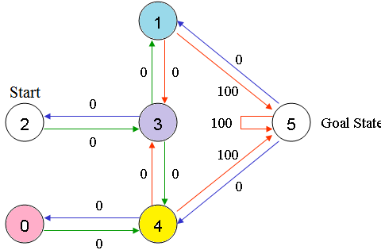
Understanding the Q – Learning

Slide 16
Understanding the Q – Learning: Prepare matrix Q
Matrix Q is the memory of the agent in which learned information from experience is stored.
Row denotes the current state of the agent
Column denotes the possible actions leading to the next state Compute Q matrix:
Q(state, action) = R(state, action) + Gamma * max[Q(next state, all actions)]
Gamma is discounting factor for future rewards. Its range is 0 to 1.
i.e. 0 < Gamma <1.
Future rewards are less valuable than current rewards so they must
be discounted.
If Gamma is closer to 0, the agent will tend to consider only the immediate rewards.
If Gamma is closer to 1, the agent will tend to consider only future rewards with higher edge weights.

Slide 17
Q – Learning Algorithm
Set the gamma parameter
Set environment rewards in matrix R
Initialize matrix Q as Zero
Select random initial (source) state
Set initial state s = current state
– Select one action a among all possible actions using exploratory policy
Take this possible action a, going to the next state s’.
Observe reward r
Get maximum Q value to go to next state based on all possible
actions
Compute:
Q(state, action) = R(state, action) + Gamma * max[Q(next state, all actions)]
Repeat the above steps until reach the goal state i.e current state =
goal state

Slide 18
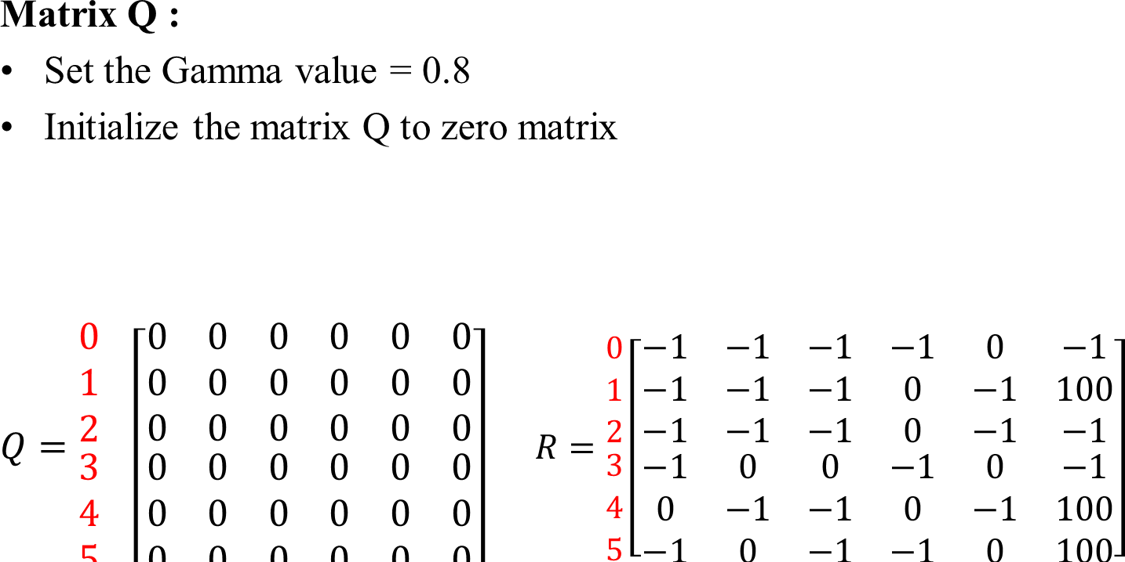
Example: Q – Learning
Action
3
0 1 2 3 4 5
State
0
1
2
4
5

Slide 19
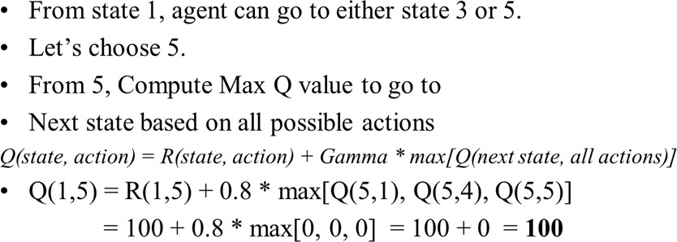
Example: Q – Learning
3
1
4
1
5
5
Update the Matrix Q.
Action
0 1 2 3 4 5
𝟎 −1 −1 −1 −1 0 −1
𝟏 −1 −1 −1 0 −1 100
State 0 1 2 3 4 5
𝟎 0 0 0 0 0 0
𝟏 0 0 0 0 0 𝟏𝟎𝟎
𝑅 = ^{𝟐}
−1 −1 | −1 0 | −1 0 | 0 −1 | −1 0 | 100 −1 | Q = ^{𝟐} 𝟑 | 0 0 | 0 0 | 0 0 0 0 0 0 | 0 0
0 | −1 | −1 | 0 | −1 | 100 | 𝟒 | 0 | 0 | 0 0 0 | 0
−1 | 0 | −1 | −1 | 0 | 100 | 𝟓 | 0 | 0 | 0 0 0 | 0
𝟑
𝟒
𝟓

Slide 20
For next episode, choose next state 3 randomly that
becomes current state.
State 3 contains 3 choices i.e. state 1, 2 or 4.
Let’s choose state 1.
Compute max Q value to go to next state based
on all possible actions.
3
1
5
2
3
4
Q(state, action) = R(state, action) + Gamma * max[Q(next state, all actions)]
Q(3,1) = R(3,1) + 0.8 * max[Q(1,3), Q(1,5)]
= 0 + 0.8 * max[0, 100] = 0 + 80 = 80
Update the Matrix Q.
Action
0 | 1 | 2 | 3 | 4 | 5 | State 0 |  |  | 1 | 2 | 3 |  | 4 |  | 5
−1 | −1 | −1 | −1 | 0 | −1 | 𝟎 |  | 0 | 0 | 0 |  | 0 |  | 0 | 0
−1 | −1 | −1 | 0 | −1 | 100 | 𝟏 |  | 0 | 0 | 0 |  | 0 |  | 0 | 100
−1 −1 | −1 0 | −1 0 | 0 −1 | −1 0 | 100 −1 | Q = ^{𝟐} 𝟑 | 0 0 |  | 0 𝟖𝟎 | 0 0 | 0 0 |  |  | 0 0 | 0 0
0 | −1 | −1 | 0 | −1 | 100 | 𝟒 | 0 |  | 0 | 0 | 0 |  |  | 0 | 0
−1 | 0 | −1 | −1 | 0 | 100 | 𝟓 | 0 |  | 0 | 0 | 0 |  |  | 0 | 0
𝟎
𝟏
𝑅 = ^{𝟐}
𝟑
𝟒
𝟓

Slide 21
For next episode, next state 1 becomes current state
Repeat the inner loop due to 1 is not target state
From State 1, either can go to 3 or 5.
3
1
Let’s choose state 5.
Compute max Q value to go to next state based on all possible actions.
Q(state, action) = R(state, action) + Gamma * max[Q(next state, all actions)]
Q(1,5) = R(1,5) + 0.8 * max[Q(5,1), Q(5,4), Q(5,5)]
= 100 + 0.8 * max[0, 0, 0] = 100 + 0 = 100
4
1
5
5
Q remains the same due to Q(1,5) is already fed into the agent. Stop process
Action
𝟎
𝟏
0 | 1 | 2 | 3 | 4 | 5 | State 0 |  |  | 1 | 2 | 3 |  | 4 |  | 5
−1 | −1 | −1 | −1 | 0 | −1 | 𝟎 |  | 0 | 0 | 0 |  | 0 |  | 0 | 0
−1 | −1 | −1 | 0 | −1 | 100 | 𝟏 |  | 0 | 0 | 0 |  | 0 |  | 0 | 100
−1 −1 | −1 0 | −1 0 | 0 −1 | −1 0 | 100 −1 | Q = ^{𝟐} 𝟑 | 0 0 |  | 0 𝟖𝟎 | 0 0 | 0 0 |  |  | 0 0 | 0 0
0 | −1 | −1 | 0 | −1 | 100 | 𝟒 | 0 |  | 0 | 0 | 0 |  |  | 0 | 0
−1 | 0 | −1 | −1 | 0 | 100 | 𝟓 | 0 |  | 0 | 0 | 0 |  |  | 0 | 0
𝑅 = ^{𝟐}
𝟑
𝟒
𝟓

Slide 22
References
Tom Markiewicz& Josh Zheng,Getting started with Artificial Intelligence,
Published by O’Reilly Media,2017
Stuart J. Russell and Peter Norvig,Artificial Intelligence A Modern Approach
Richard Szeliski, Computer Vision: Algorithms and Applications, Springer 2010

